Slide 1
Forces
Year 7 Science

Slide 2
Preview
Science understanding - Physical sciences Change to an object’s motion is caused by unbalanced forces acting on the object. Earth’s gravity pulls objects towards the centre of the Earth. | Science understanding - Physical sciences Change to an object’s motion is caused by unbalanced forces acting on the object. Earth’s gravity pulls objects towards the centre of the Earth.
1 | Forces Types, Contact and Non-Contact Forces | Module 7.1 | Looking at Forces pg. 288 Measuring Forces pg. 289
2 | Friction- A Contact Force | Module 7.2 | Friction and Mass pg.298
3 | Gravity- A Non-Contact Force Magnetic and Electric Fields | Module 7.3 Module 7.4 | Marble Investigating Static Electricity pg. 321e Run pg.310
4 | Simple Machines Levers Types of Levers | Module 7.5 |  | Levers Inquiry
5 | Science Week Activities
6- 7 | Inclined planes Pulleys and Wheels Gears Revision | Module 7.5 | Using Ramps pg. 333 Chapter Review pg. 336 | Physics 1 Test

Slide 3
Preview
Science understanding - Physical sciences Change to an object’s motion is caused by unbalanced forces acting on the object. Earth’s gravity pulls objects towards the centre of the Earth. | Science understanding - Physical sciences Change to an object’s motion is caused by unbalanced forces acting on the object. Earth’s gravity pulls objects towards the centre of the Earth.
1 | Forces Types, Contact and Non-Contact Forces | Module 7.1 | Looking at Forces pg. 288 Measuring Forces pg. 289
2 | Friction- A Contact Force | Module 7.2 | Friction and Mass pg.298
3 | Gravity- A Non-Contact Force Magnetic and Electric Fields | Module 7.3 Module 7.4 | Marble Investigating Static Electricity pg. 321e Run pg.310
4 | Simple Machines Levers Types of Levers | Module 7.5 |  | Levers Inquiry
5 | Science Week Activities
6- 7 | Inclined planes Pulleys and Wheels Gears Revision | Module 7.5 | Using Ramps pg. 333 Chapter Review pg. 336 | Physics 1 Test

Slide 4
Preview
Science understanding - Physical sciences Change to an object’s motion is caused by unbalanced forces acting on the object. Earth’s gravity pulls objects towards the centre of the Earth. | Science understanding - Physical sciences Change to an object’s motion is caused by unbalanced forces acting on the object. Earth’s gravity pulls objects towards the centre of the Earth.
1 | Forces Types, Contact and Non-Contact Forces | Module 7.1 | Looking at Forces pg. 288 Measuring Forces pg. 289
2 | Friction- A Contact Force | Module 7.2 | Friction and Mass pg.298
3 | Gravity- A Non-Contact Force Magnetic and Electric Fields | Module 7.3 Module 7.4 | Marble Investigating Static Electricity pg. 321e Run pg.310
4 | Simple Machines Levers Types of Levers | Module 7.5 |  | Levers Inquiry 5%
5 | Science Week Activities
6- 7 | Inclined planes Pulleys and Wheels Gears Revision | Module 7.5 | Using Ramps pg. 333 Chapter Review pg. 336 | Physics 1 Test 9%

Slide 5
Learning Intentions
Change to an object’s motion is caused by unbalanced forces acting on the object.
investigating the effects of applying different forces to familiar objects

Slide 6
Success criteria
Define force.
Classify forces as pushes or pulls.
Classify forces as contact or non-contact.

Slide 7


Slide 8
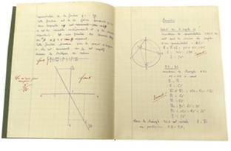
Forces 18/07/2024
A force is a push or pull that acts upon an object, as a result of that object’s interactions with its surroundings.
Forces can move an object or change its shape.
Forces can be contact or non-contact.

Slide 9
Forces 18/07/2024
Contact | Non-Contact
Objects are touching | Objects are at a distance

Slide 10

Frictional

Slide 11
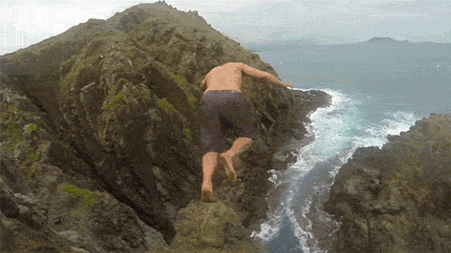
Gravitational

Slide 12
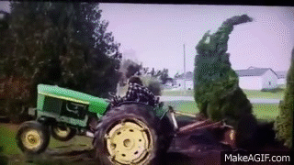
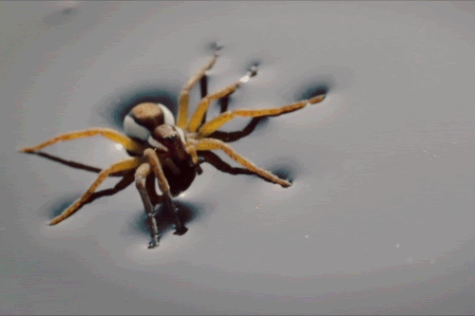
Tension

Slide 13
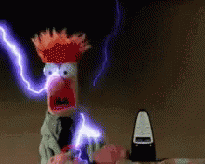
Electrical

Slide 14
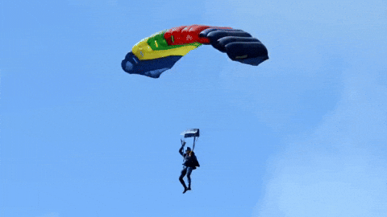
Air resistance

Slide 15
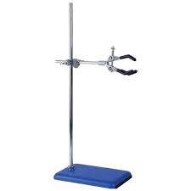
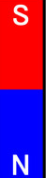
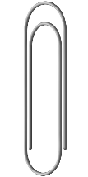
Magnetic

Slide 16
Success criteria
Define force.
Classify forces as pushes or pulls.
Classify forces as contact or non-contact.

